Slide 1
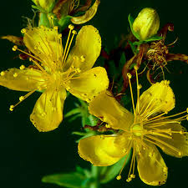
The Importance of St. John's Wort in Modern Herbal Medicine
Anu Gamage - Research Scientist (Sul’s Research Group, Global-Chemistry Inc)

Slide 2
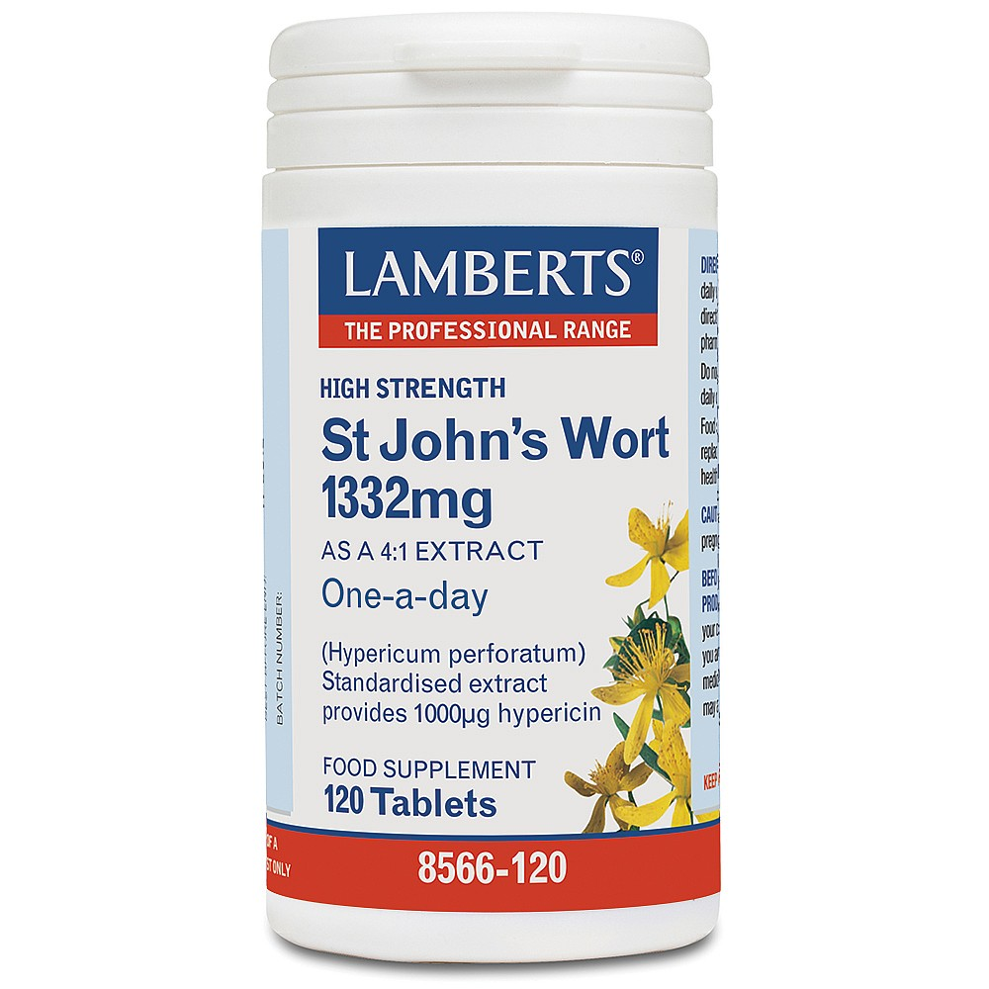
Background
Flowering plant native to Europe and Asia
Scientific name : Hypericum perforatum
Anti-depressive or anxiolytic
Used to treat menopausal somatic symptoms, obsessive-compulsive disorder, behavioral issues, and psoriasis
Herbal supplement has not been given FDA approval and is considered a dietary supplement.

Slide 3
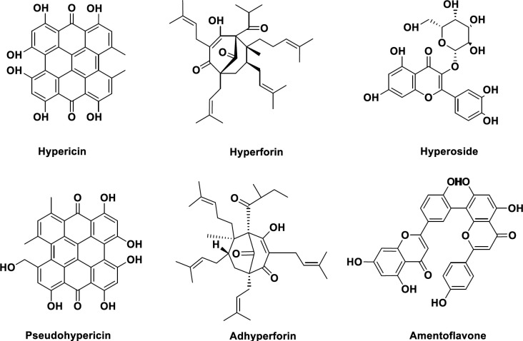
Chemical Constituents and Use Cases
Consists of anthraquinones
The therapeutical important compounds in Hypericum species include phloroglucinols including hyperforin, naphthodianthrones including hypericin and pseudohypericin, and flavonoids such as quercetin, quercitrin, rutin, and hyperoside

Slide 4
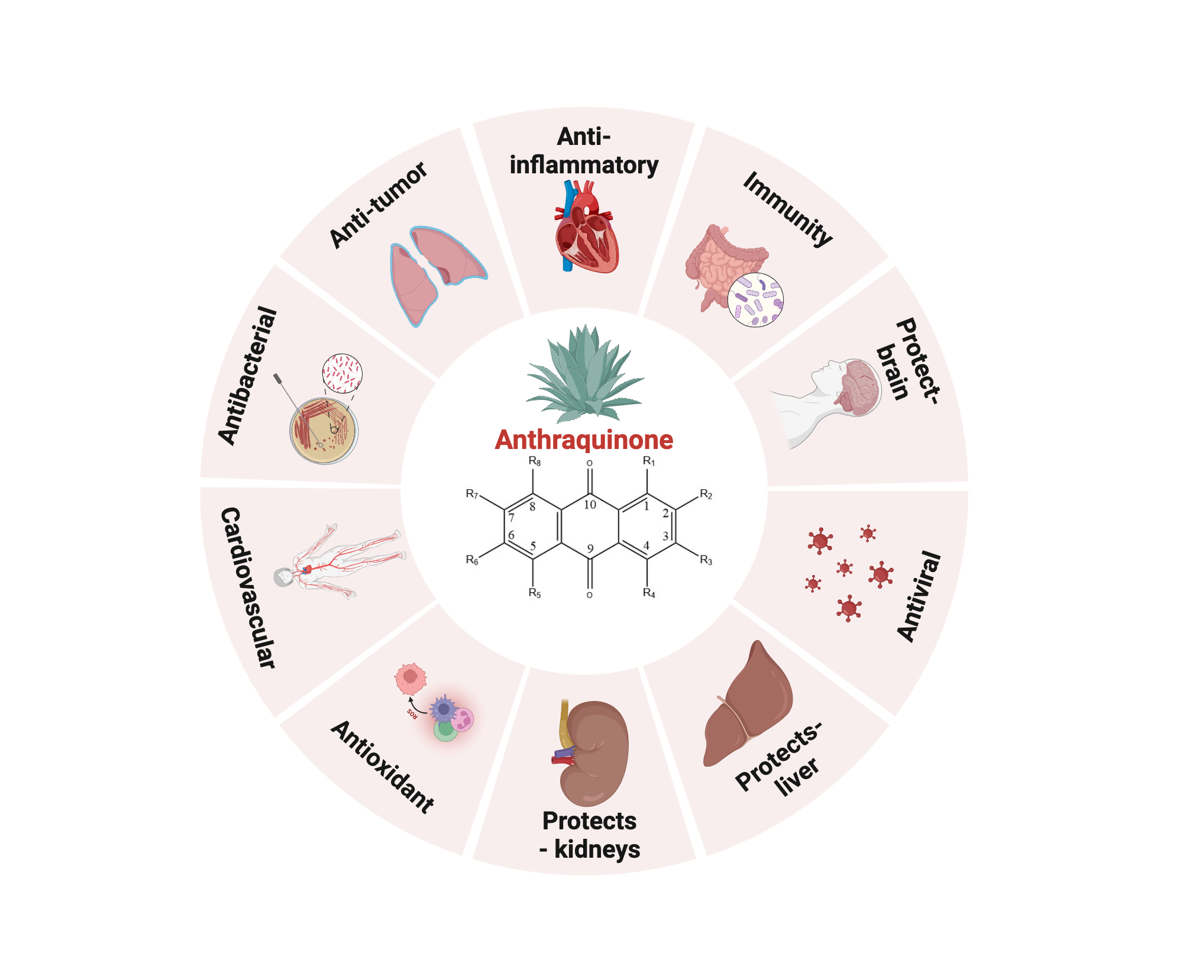

Slide 5
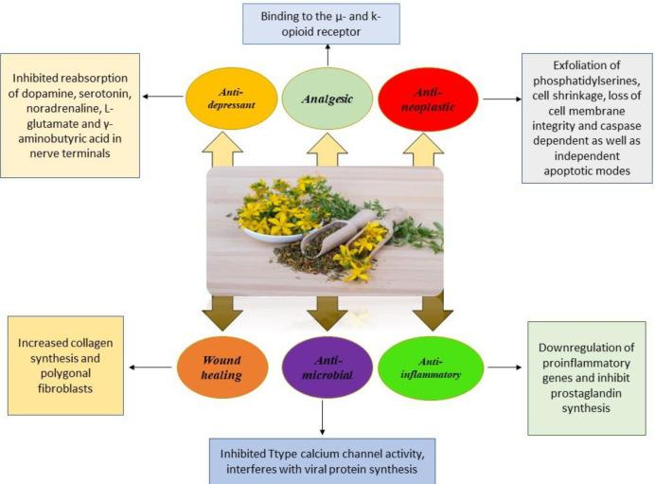

Slide 6
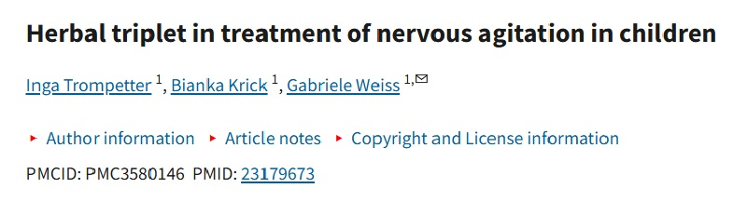
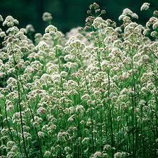
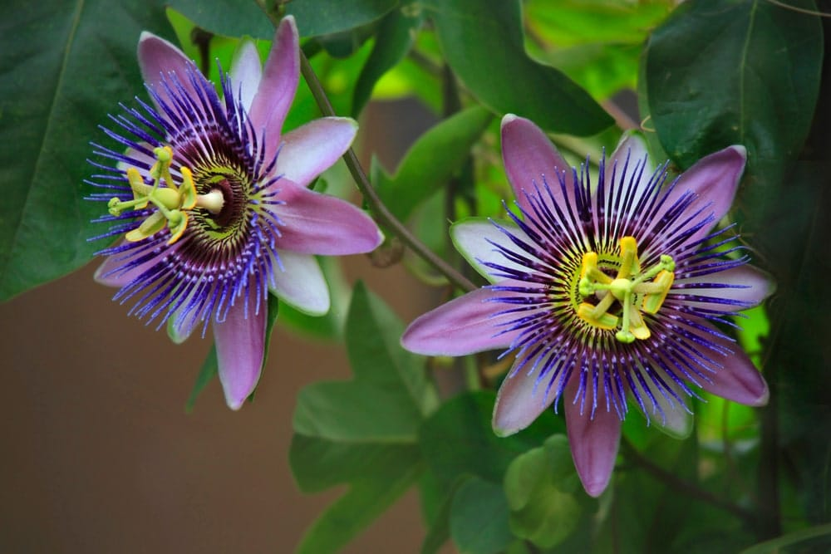
Tested herbal combination of St. John’s Wort, Valerian, and Passionflower

Slide 7
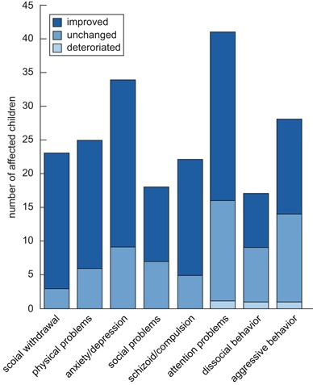
Altogether, up to 69.6 % of children who were assessed as “borderline abnormal” or “abnormal” reached a “normal” assessment at the end of the observation period. The therapeutic success was not influenced by concomitant medication or therapies due to inclusion diagnosis.
Parents prefer nonmedical therapies as initial treatment because of the higher risk of side effects in therapies with chemical medication
For these families, the tested herbal combination of St. John’s Wort, Valerian, and Passionflower offers a good alternative and fulfills the requested aspects
presented study showed that the study medication is useful in situations of psychological mood disorders and sleep disorders due to nervousness also in children between 6 and 12 years of age.

Slide 8
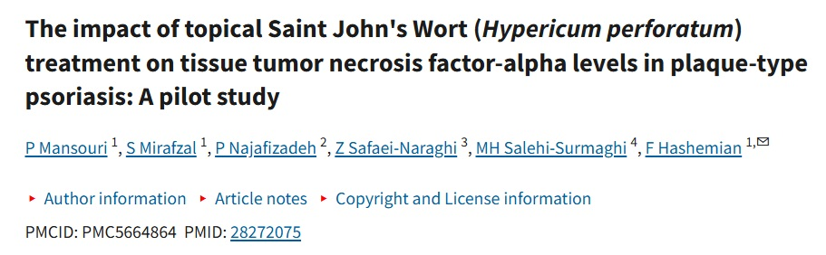
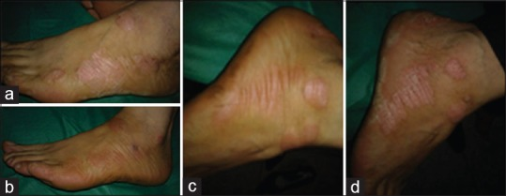
Clinical images before and after the treatment. (a) Left foot before treatment. (b) Left foot after treatment with drug. (c) Right foot before treatment. (d) Right foot after treatment with base ointment
Researchers use topical Hypericum perforatum to treat plaque-type psoriasis, an inflammatory disorder, where tumor-necrosis factor-alpha (TNFα) is commonly found in psoriatic skin tissues. The study found that the anti-inflammatory capabilities of Hypericum perforatum ointment lowered cytokine content, including TNFα, in psoriatic lesions

Slide 9
Depression
Obsessive-compulsive disorder
Premenstrual syndrome (PMS)
Reference :
https://www.ncbi.nlm.nih.gov/books/NBK557465/
https://www.ncbi.nlm.nih.gov/books/NBK92750/
https://pmc.ncbi.nlm.nih.gov/articles/PMC9526892/#:~:text=It%20is%20a%20very%20popular,obesity%20(4%2C%205).
https://www.sciencedirect.com/topics/pharmacology-toxicology-and-pharmaceutical-science/pseudohypericin

